Slide 1
TU856-1 and TU858-1 Computer Architecture and Technology
Thursday 6 March 2025
(Week 6) Tutorial 4

Slide 2

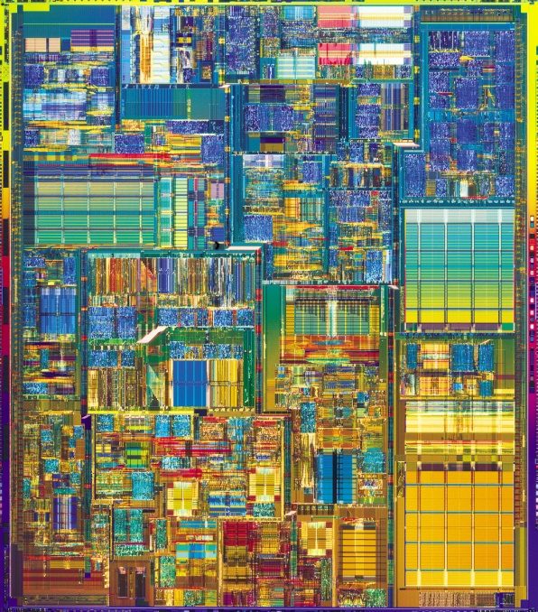
Sequential Logic Questions and Answers ( 1 )
What is in here?
This!
What is in here?
This!

Slide 3
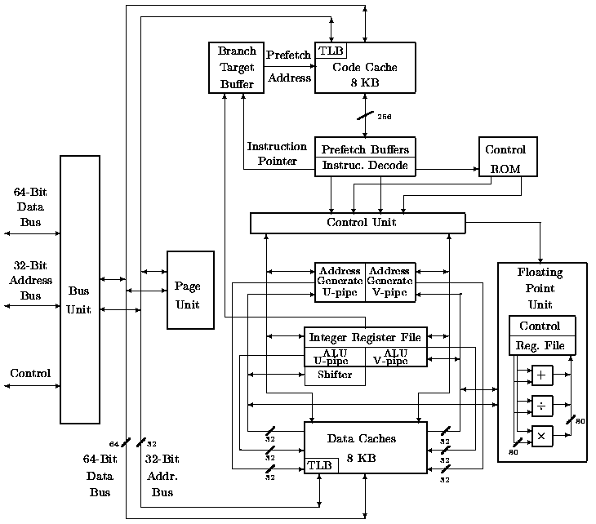
Sequential Logic Questions and Answers ( 2 )
What is in here?
This!

Slide 4
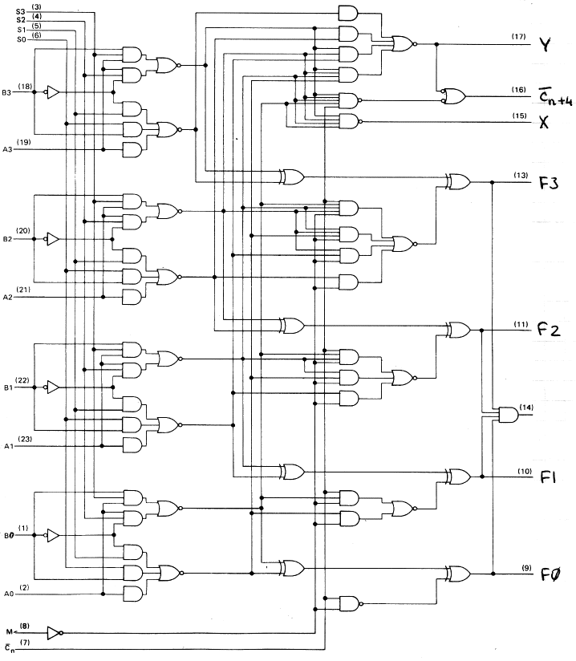
Sequential Logic Questions and Answers ( 3 )
LOGIC GATES in an ALU!
Oh!! That is what is in there!
(And all through the processor, RAM and ROM!

Slide 5
The R-S Flip Flop Show
This NOR gate R-S flip-flop animation will run if you are running the Slide Show – or see it at this Web site:
http://commons.wikimedia.org/wiki/File:R-S.gif
The clip on this link is also a NOR gate R-S flip-flop animation and its is very clear in its demo. Good old YouTube!!
http://www.youtube.com/watch?v=--pv3MZMoo0

Slide 6
J-K Flip Flop Sequence
https://www.wisc-online.com/learn/technical/electronics-digital/dig4203/building-a-binary-counter-with-a-jk-flip-flop
Above is a link for a very informative ‘Building a Binary Counter with a J-K Flip-Flop’ animation.
Click on the ‘Next arrows’ to go through the sequence. You will love it, I am sure.

Slide 7
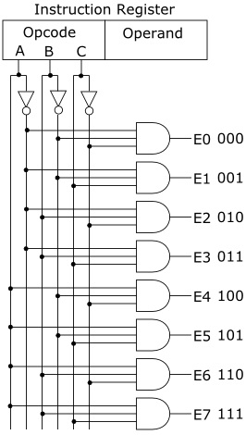
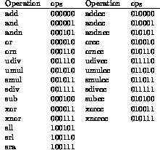
Sequential Logic and OpCodes
An opcode/gates relationship example
Operation codes as binary – you can imagine these binary combinations being generated with gate combinations

Slide 8
Typical Exam (Sub) Question For This Content
Question
Using written and/or diagrammatic explanations, compare the flip-flop and latch circuits of a microprocessor and specify their main difference.
Sample solution
Flip-Flops and Latches
There are many examples of sequential logic circuits, the common named types being ‘latches’ and ‘flip-flops’.What are latch and flip-flop circuits made of? Gates: NAND and NOR gates, mostly, with NOT gates where required.
An asynchronous latch is an electronic sequential logic circuit used to store information in an asynchronous arrangement. (Asynchronous: they have no Clock input.)
One latch can store one bit. They change output state only in response to data input.
Essentially, they hold a bit value and it remains constant until new inputs force it to change. A type of single-bit stable storage.

Slide 9
Solution continued
As with latches, flip-flops are another example of a circuit employing sequential logic. A flip-flop can also be called a bistable gate. A type of single-bit storage but not as stable as a latch. A basic flip-flop has two stable states.
The flip-flop maintains its states indefinitely until an input pulse (a trigger from the clock) is received. If a trigger is received, the flip-flop outputs change their states according to defined rules, and remain in those states until another trigger is received.

Slide 10
Solution continued
The main difference between a latch and flip-flop: latches are level-sensitive while flip-flops are edge-sensitive. Both might require the use of a clock signal and are used in sequential logic. (The clock on the latch is for synchronisation whereas the clock on the flip-flop may trigger a change in output.)
For a latch, the output tracks the input when the clock signal is high, so as long as the clock is logic 1 the output can change if the input also changes. (Logic 1 + new data = new output)
Flip-flops, in comparison, will store the input only when there is a rising/falling edge of the clock. (Edge-triggered, so may flip on clock pulses.)
(10 marks)

